Slide 1
CEME Team 2
ManJUNATH Prabhu
Amanda Chu
Santhi muvva

Slide 2
Database Design
Database: Mongo DB
Table Name: Customer
Columns:
First Name String
Middle Initial String
Last Name String
Street Address String
City String
State String
Zip Code String
Phone Number String
Email String
Gender String
Birthday Date/String

Slide 3
Springboot rest api
Controller REST API
Service Layer
Contains business logics
Data Layer
Contains entities and data mapping
Custom Query Demo

Slide 4
jenkins
Jenkins pipelines for both Springboot REST API and REACT Application.
Successfully build and deploy
DEMO

Slide 5
Github
https://github.com/achuu126/CEMEFinalProject
Project Folders:
- SpringbootRestAPI
- ReactApp

Slide 6
UI Design
Assumptions:
Users are Agents/Allstate employees
Users be able to add/delete/update(policy holders)
Code Design
Rest API
React Redux
Functional components
DEMO

Slide 7
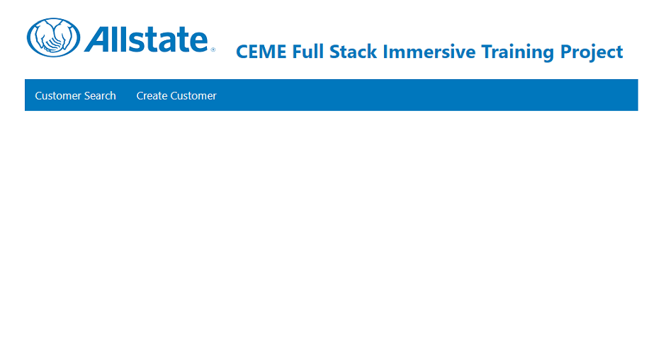
Main screen

Slide 8
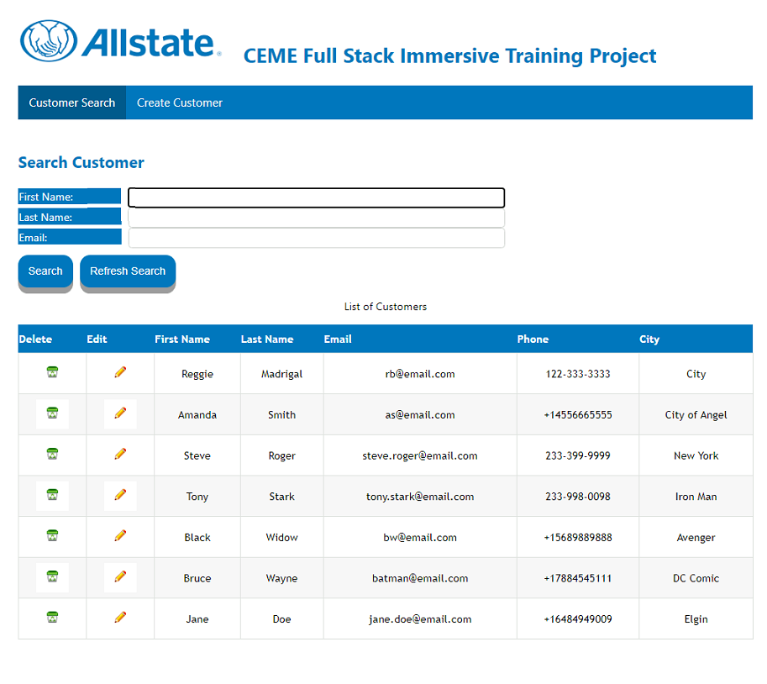
Search screen
Search Button - Search by First Name and or Last Name and or Email.
Refresh Search Button – refresh screen and display all customers
Delete Icon button will delete the selected customer
Edit Icon button will open Customer Update page.

Slide 9
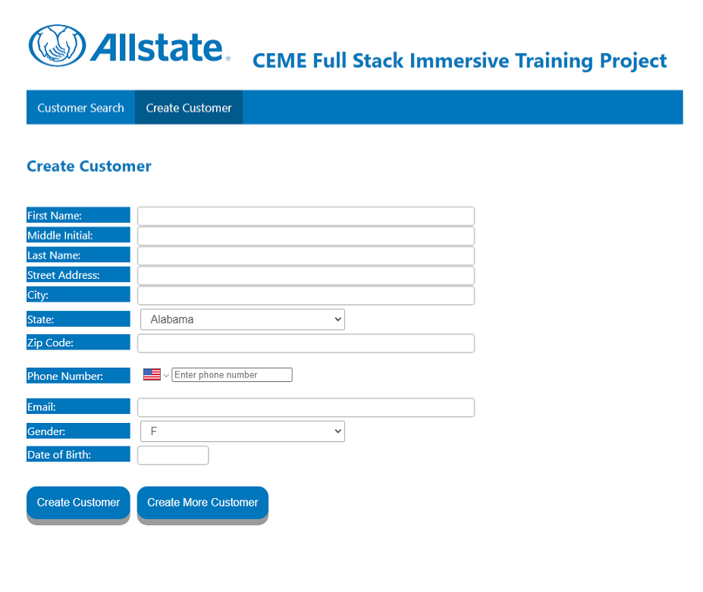
Create customer screen
Input fields for Customer entity
Create Customer – save new customer into the database and return to Search Customer page.
Create More Customer – save new customer in database and remain in the page to enter another customer.

Slide 10
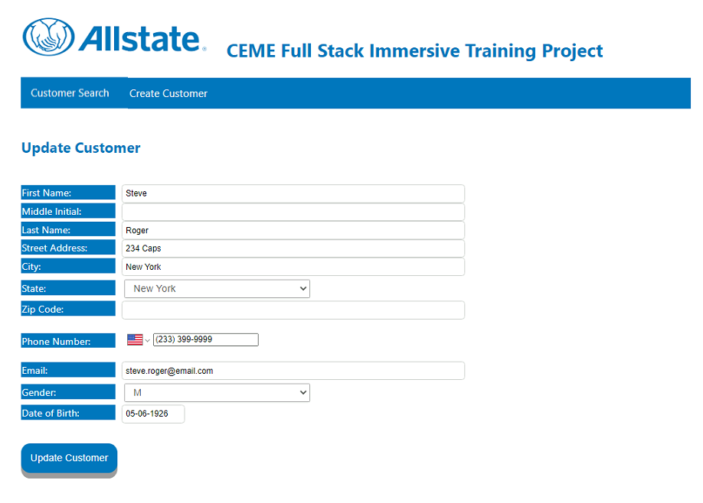
Update Customer screen
Customer input fields for update existing data
Update Customer Button – Save selected customer data into database

Slide 11
q&a
Thank you from CEME Team 2

